Slide 1

Road Segmentation Using DeepLabV3+
Subtitle: AI Capstone Project
Diep – nguyen9657@saskpolytech.ca
Harnil - patel7344@saskpolytech.ca
Do – thin0013@saskpolytech.ca

Slide 2
Objectives
Main Goal:
Implement and evaluate the DeepLabV3+ model for road segmentation in satellite imagery.
Aims:
Utilize DeepLabV3+'s advanced features (e.g., atrous convolution) to effectively segment roads in various urban and rural environments.
Measure and analyze performance using metrics like Accuracy, Intersection over Union (IoU), and Dice Coefficient.

Slide 3
Project Timeline
Model Optimization/Improvement
Analyze baseline performance to optimize & improve model
Implement, train and evaluate the optimized/improved model
Compare results among the baseline & optimized/improved model
Validation, Testing
Perform cross-validation to ensure model robustness
Test the model on the test set & compute final metrics
Visualize predictions, analyze failure cases & identify potential improvements
Project Planning and Data Collection
Research and finalize topic with suitable datasets
Define project goals, scope, & success metrics
Prepare high level proposal & presentation
Set up the development environment
Feb 2025
Apr 2025
Jan 2025
Mar 2025
Data Preprocessing and Exploration
Load and explore the dataset (Visualize satellite images & road mask)
Preprocess the data (Resize, normalize, split data)
Augment the dataset (Rotation, flipping, cropping)
Model Selection and Baseline Development
Select model and implement a baseline model
Train and evaluate the baseline model
Deployment
Convert the trained model to a deployable format
Develop a simple pipeline for inference & test
Finalization and Documentation
Prepare a detailed project report & presentation
Conclude the project with programming codes & reports

Slide 4
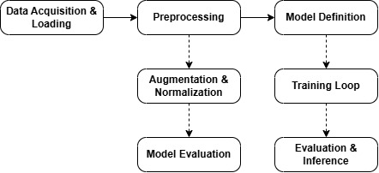
Detail Project Block diagram

Slide 5
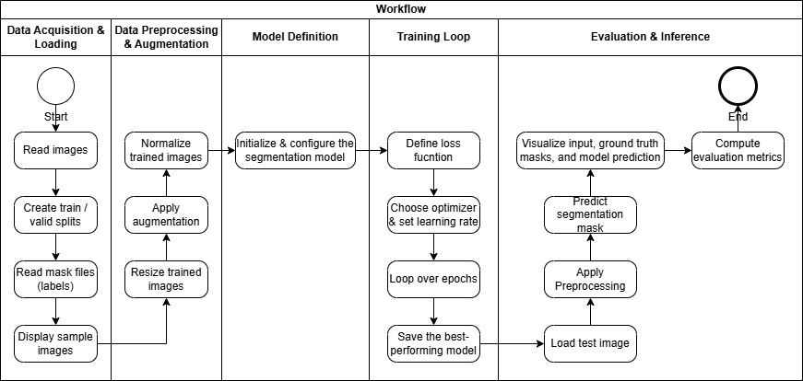
Project Flowchart

Slide 6
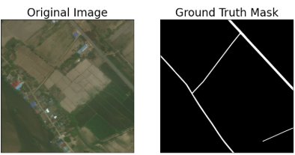
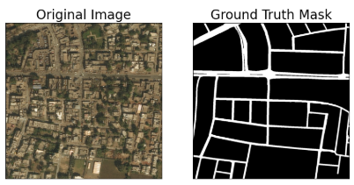
Dataset Used
Dataset Source:
Kaggle, containing high-resolution satellite images with road network annotations
(https://www.kaggle.com/datasets/balraj98/deepglobe-road-extraction-dataset/data).
Images: 6,226
Masks: 6,226
Sample Images & Masks

Slide 7
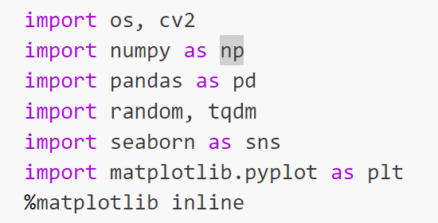
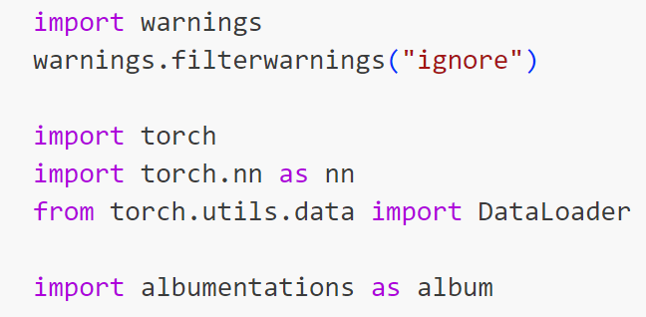
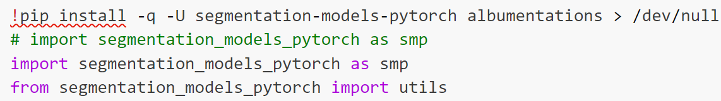
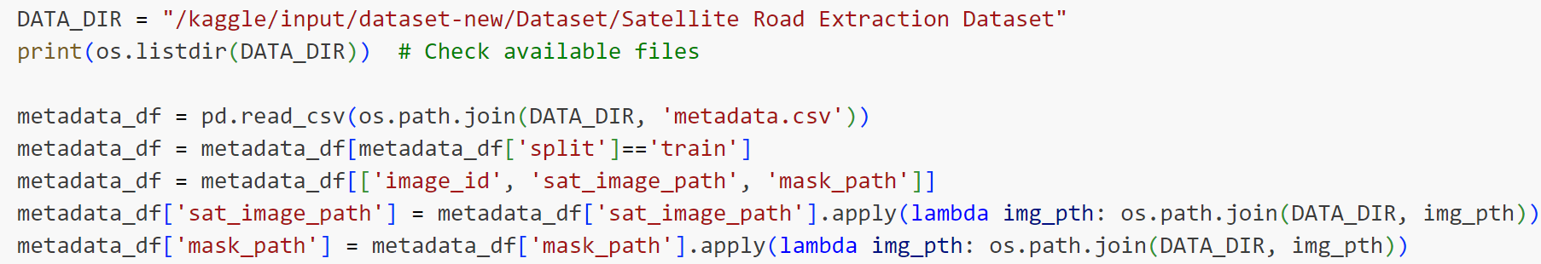
Detail Data Preprocessing (1/2)
Import Libraries
Numpy, pandas, torch, cv2, matplotlib
Load the Dataset
Dataset sourced from Kaggle
Albumentations for data augmentation
Segmentation_models_pytorch for deep learning model
Metadata file: metadata.csv
Load using Pandas: pd.read_csv()
Filter for training data

Slide 8
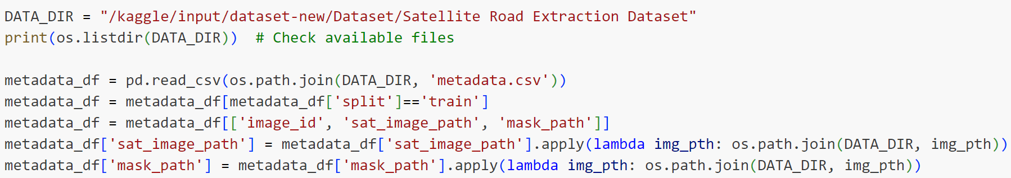
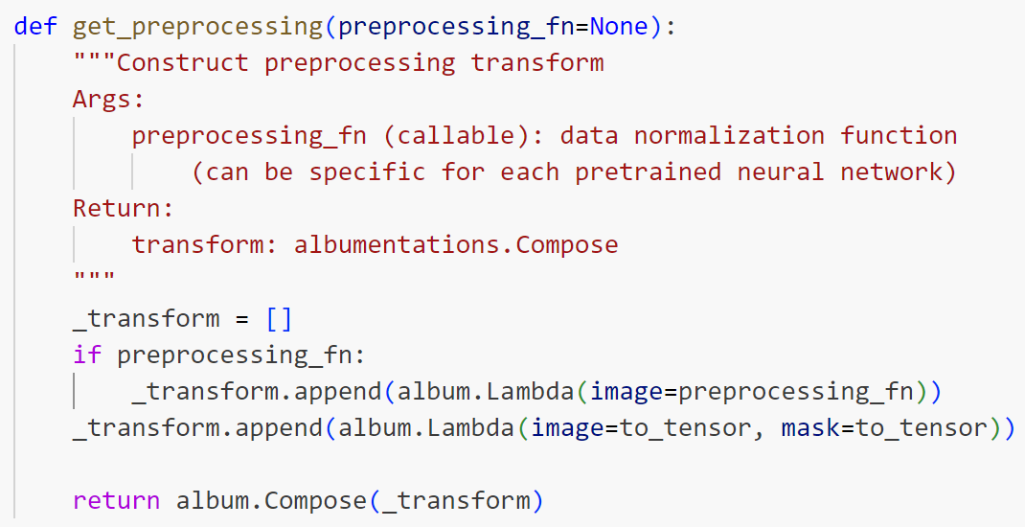
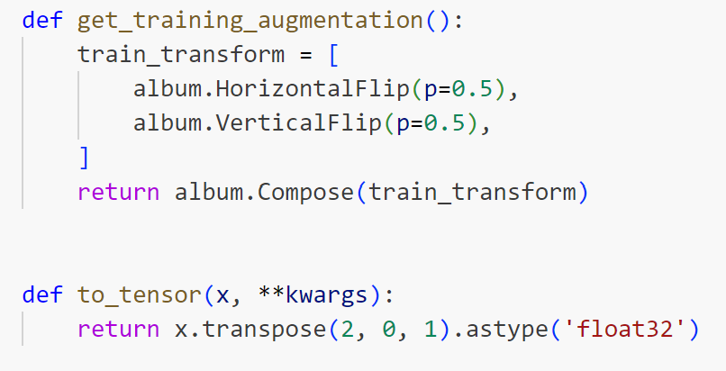
Detail Data Preprocessing (2/2)
Path Adjustments
Convert relative paths to absolute paths
Data Augmentation
Use Albumentations for transformations
Ensure model generalization
HorizontalFlip
Normalize trained images

Slide 9
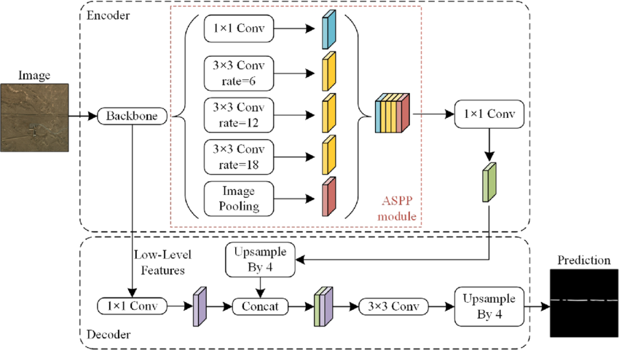
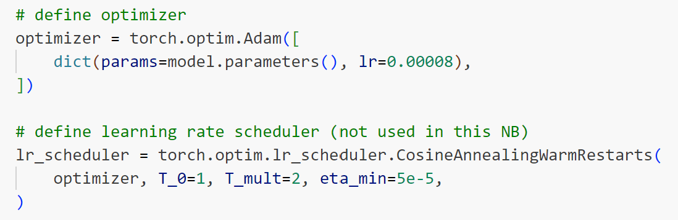
Modelling
Model Architecture - DeepLabV3+
Base Model: DeepLabV3+ with ResNet-50 backbone
Training Configuration
Optimizer: Adam with learning rate scheduling.
Key Features
Atrous Spatial Pyramid Pooling (ASPP) for multi-scale context
Encoder-Decoder structure for high-resolution segmentation
Batch Size: 2
Epochs: 3
Augmentations: Applied to improve generalization.
Hardware: Trained on GPU
Model Evaluation Metrics
Metrics Used
Intersection over Union (IoU)
Dice Coefficient
Pixel Accuracy
Results Visualization
Display sample predictions vs. ground truth masks

Slide 10
Results and Analysis
 | DeepLabV3+ | U-Net
Architecture | Semantic segmentation model designed for pixel-wise classification | Fully convolutional network designed for image segmentation
Loss Function | Cross-Entropy Loss (used during training) | Binary Cross-Entropy Loss.
Metrics | IoU and Dice Coefficient Comparison | Accuracy, IoU and Dice Coefficient Comparison

Slide 11
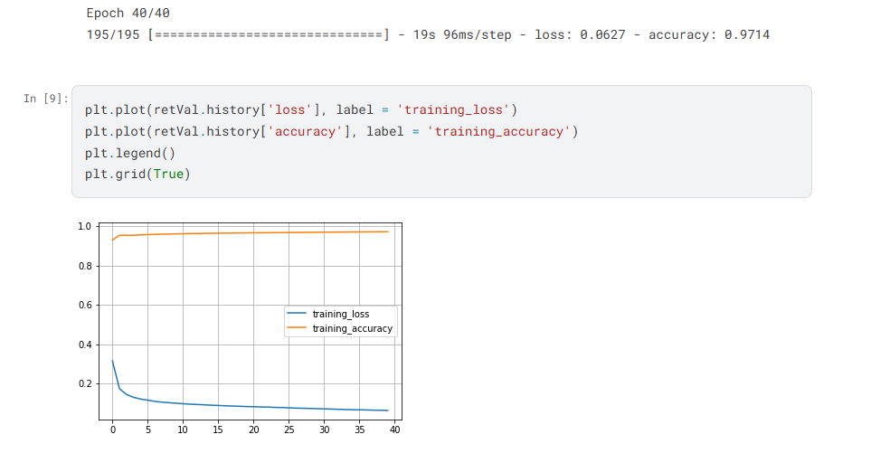
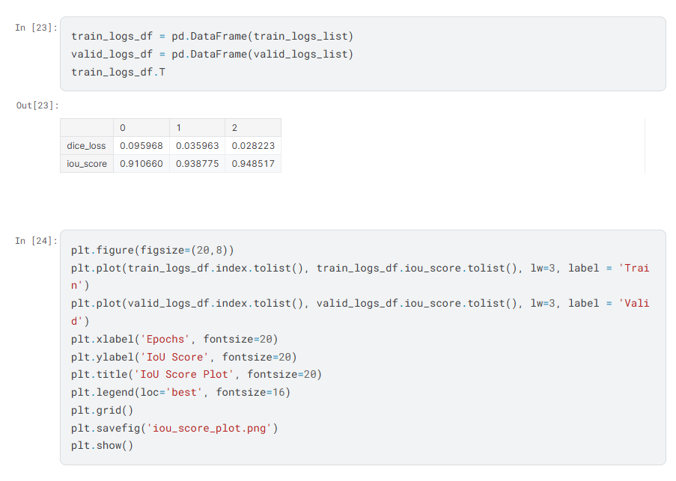
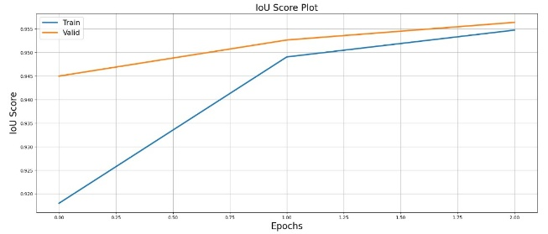
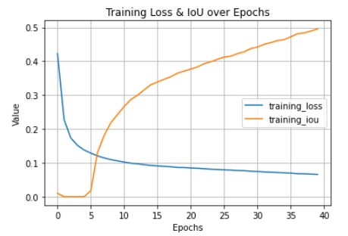
Results and Analysis ( Accuracy and IoU Comparison)
U-Net: The accuracy (97.14%) is high, but accuracy alone can be misleading because it may not capture cases where small road segments are misclassified, especially if the roads are thin or fragmented. It’s true when Mean IoU is only 49.57%.
DeepLabV3+: The Mean IoU (95.18%) indicates that DeepLabV3+ has a very high overlap between the predicted road segments and the ground truth. This means DeepLabV3+ is more precise in detecting the road areas, especially thin roads and small segments, which is harder for U-Net to capture effectively.
U-Net | DeepLabV3+

Slide 12
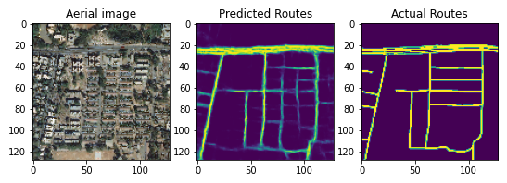
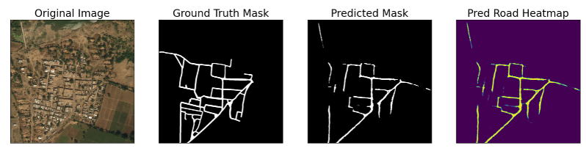
Results and Analysis (Sample Segmented Images vs. Ground Truth)
Term | Representation | Purpose
Original Mask | Raw dataset mask | Used for training/testing
Ground Truth Mask | Color-coded segmentation | Help in visualization & comparison
Predicted Mask | Model's output segmentation | Used for evaluation
One-Hot Encoded Mask | Multi-channel binary representation | Help in model training
Predicted Road Heatmap | Probability distribution of "road" pixels | Used for model confidence visualization
U-Net | DeepLabV3+

Slide 13
Results and Analysis (Loss Comparison and Model Preference)
Loss Comparison:
Both U-Net and DeepLabV3+ has the low loss with 0.0658 and 0.0261 respectively but DeepLabV3+ is better because it’s able to capture the road regions well and overlap with the ground truth effectively.
Model Preference:
If your goal is high precision in road segmentation, DeepLabV3+ with its high IoU score would likely give more accurate road boundaries, even for thin or fragmented roads.
U-Net performs well in terms of accuracy and might be preferred if real-time inference speed or less complexity is needed, especially if you want to deploy the model with fewer computational resources.

Slide 14
Results and Analysis (Considerations)
U-Net might be performing well on pixel classification but might struggle with finer details or boundaries. The high accuracy is a positive indicator, but IoU and Dice Loss suggest DeepLabV3+ captures the road segmentation better, especially for smaller or thin road areas.
DeepLabV3+ seems to have the edge when it comes to fine-tuned segmentation (judging by its high Mean IoU and low Dice Loss), which is critical for more complex road segmentation tasks.

Slide 15
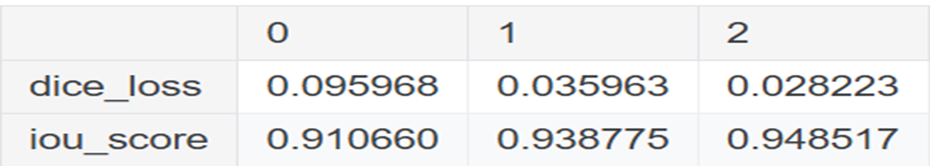
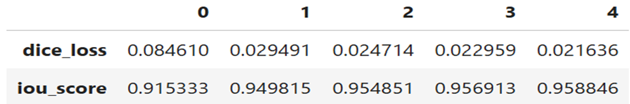
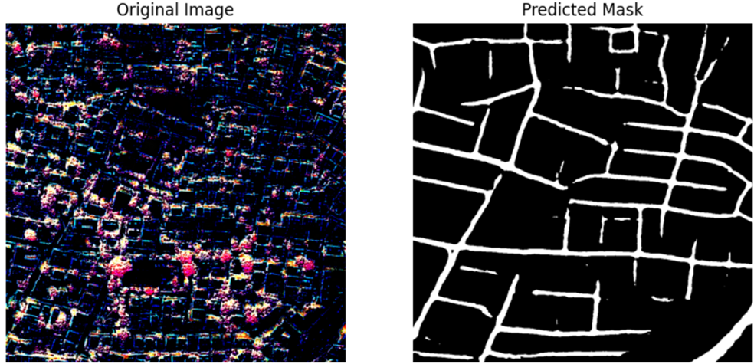
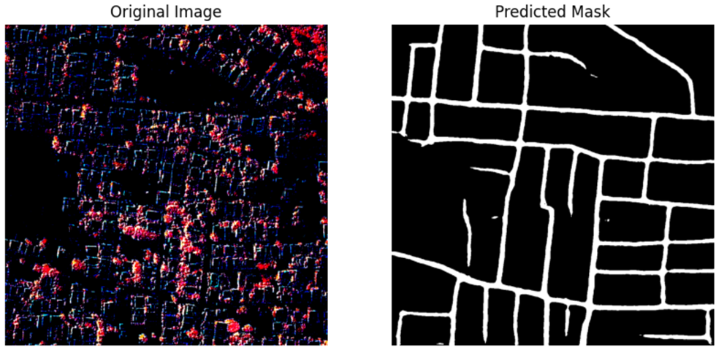
Results and Analysis (Model Enhancement)
Adjust number of Epoch from 3 -> 5
IoU increase 1%
Dice Loss reduce 0.7%
Validation
Testing

Slide 16
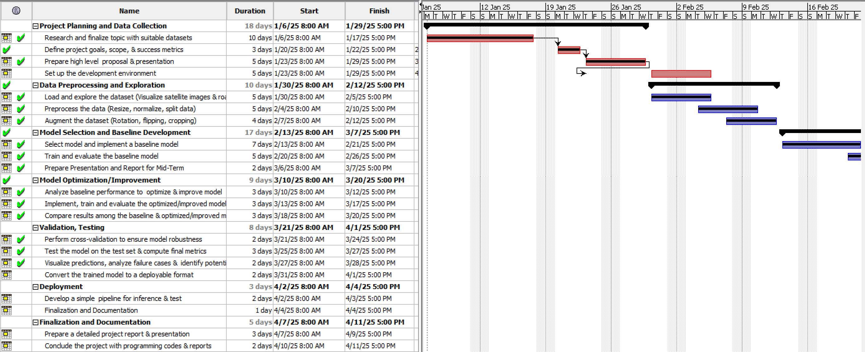
Project Progress Self-Assessment

Slide 17
References (1/2)
Liu, Y., Guo, Y., Zhang, F., & Wang, X. (2024). A Novel Network Framework on Simultaneous Road Segmentation and Vehicle Detection for UAV Aerial Traffic Images.Sensors, 24(11), 3606.
Mnih, V., & Hinton, G. (2018). "Learning to Detect Roads in High-Resolution Aerial Images." Neural Information Processing Systems (NeurIPS).
Sun, H., Wu, Y., & Zhang, J. (2021). "Improved Satellite Road Extraction Using DeepLabV3+ with Attention Mechanisms." IEEE Geoscience and Remote Sensing Letters.

Slide 18
References (2/2)
Bahrampour, S., Ramakrishnan, N., Schott, L., & Shah, M. (2015). Comparative Study of Deep Learning Software Frameworks. arXiv preprint arXiv:1511.06435.
Dubovikov, K. (2018). PyTorch vs TensorFlow — Spotting the Difference. Towards Data Science.
Al-Bdour, G., Al-Qurran, R., Al-Ayyoub, M., & Shatnawi, A. (2019). A Detailed Comparative Study of Open Source Deep Learning Frameworks. arXiv preprint arXiv:1903.00102.

